Slide 1
Practical Inversion Of Control
Matt Hinze mhinze@headspringsystems.com
Notes:
SLOW DOWN BIG GUY
About me
mhinze.com
Why I am giving this talk

Slide 2
Agenda
What is this talk about
The what and why of IOC
How to do it
Usage scenarios
Notes:
This talk is about the reasons for IOC and the ways it can benefit you
Tooling options
Principles vs. practicalities
* Showing some of the ways we use it rather than specific configurations *

Slide 3
?
Notes:
What is an IOC tool?
Delivers objects with pre-built and pre-wired dependencies right in there. An entire object graph created via configuration and reflection rather than the new operator.
Imagine you have an email sending class.. Let’s call it..

Slide 4
EmailSender

Slide 5
WorkflowStepper

Slide 6
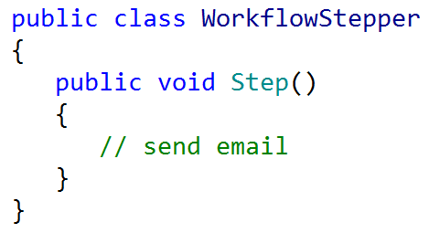

Slide 7
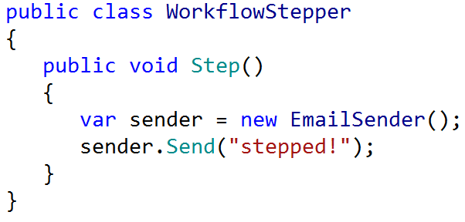
Notes:
But this – the use of the ‘new’ keyword – creates a tight coupling that is hard to change.

Slide 8
new

Slide 9
Relationship is set at compile time.
Notes:
Between objects, but also between the other dependencies of those objects. Think UI vs. Data access!

Slide 10
new isn’t always viable.
Notes:
Sometimes it’s difficult or impossible to instantiate a class.

Slide 11
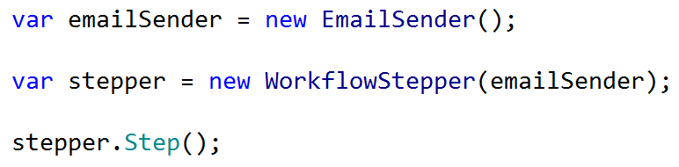
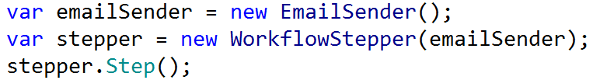
Notes:
This is dependency injection

Slide 12
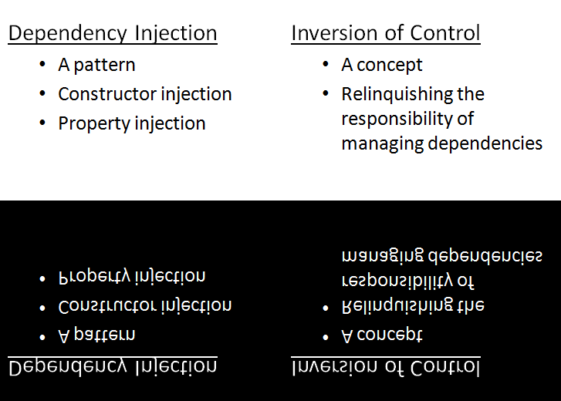

Slide 13
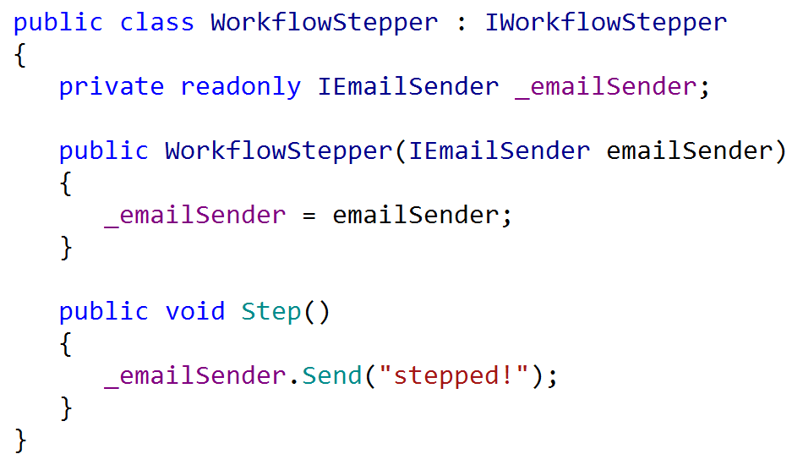
Notes:
Here is dependency injection in action.
Demo without service locator.
But imagine a number of classes, a number of dependencies, a million components, each with one job, one responsibility, one easily-tested role to play, all composed together to form an application:

Slide 14
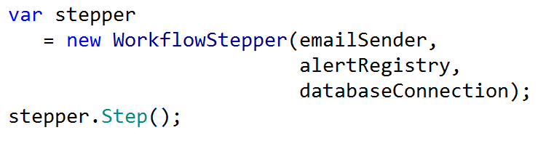
Notes:
If a service must take a dependency, the clearest way is through a constructor function parameter. Imagine an entire application composed of small, focused classes.
This is cool, because you can write classes that just do one thing. Sure they may need another class, but the interface provides the contract, but they are not responsible for choosing an implementation or instantiating the dependency. THIS is inversion of control.

Slide 15
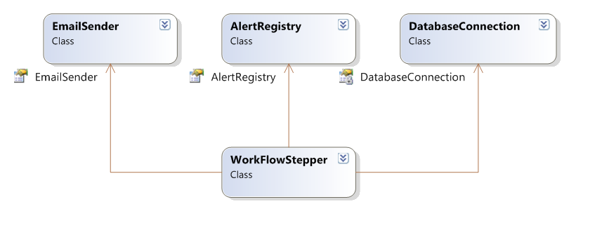
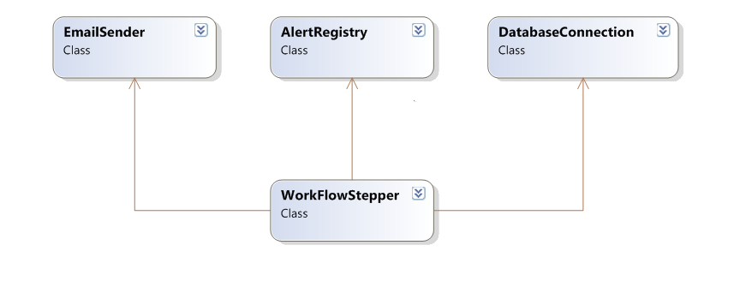
Notes:
Imagine not worrying about the details of EmailSender when you are writing WorkflowStepper or AlertRegistry…

Slide 16
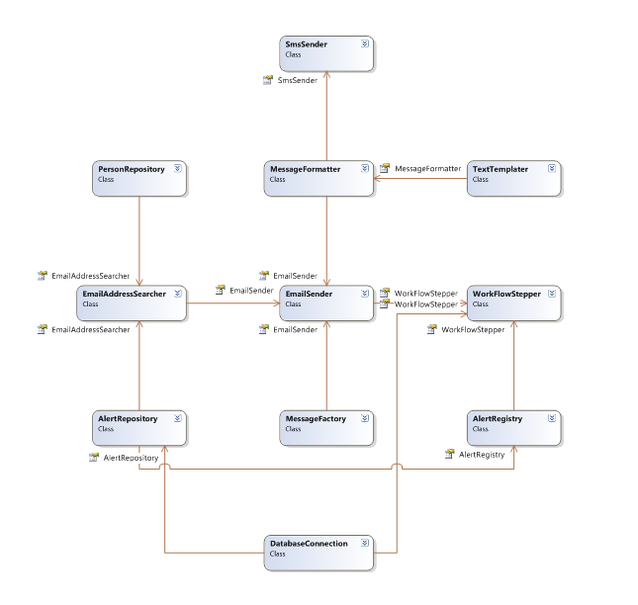
Notes:
You just worry about the concern you are working with.

Slide 17
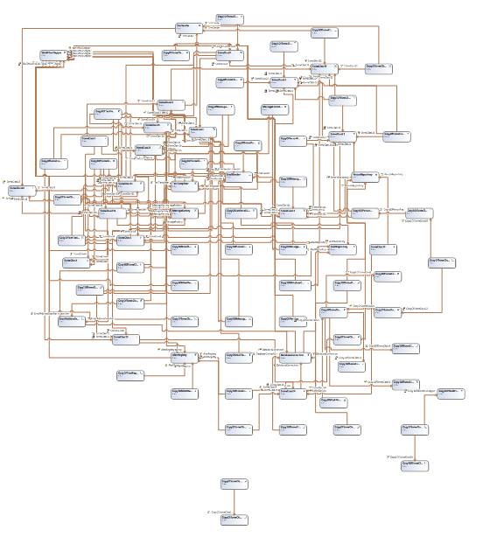
Notes:
Imagine this whole graph (tree) of objects and dependencies gets wired up at RUN TIME, so that when you do this:

Slide 18
Notes:
.. you get a real deal WorkflowStepper with all the dependencies automatically filled in where you need them.
Service Locator pattern

Slide 19
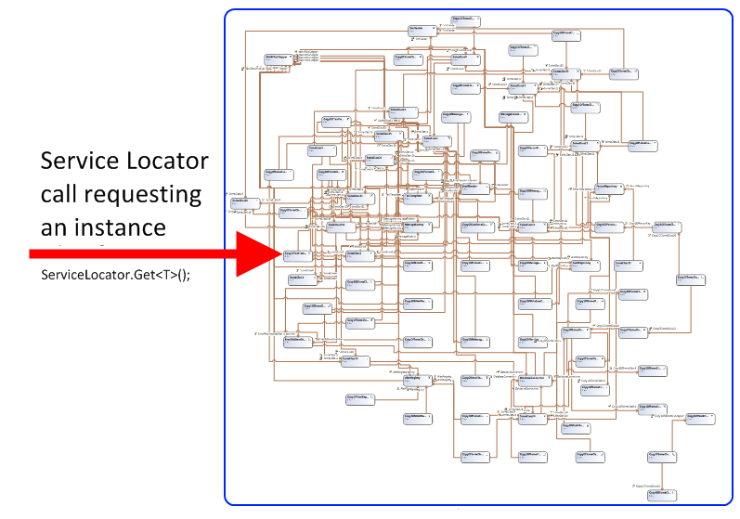
Notes:
The red arrow is the entry point
The components live inside the IOC tool
The IOC tool manages the application

Slide 20
There is no new
Notes:
Finish demo here.

Slide 21
Some Benefits Enumerated
Testing
Reuse
Simplicity
Construction velocity
Fun
Notes:
Makes it easy to isolate classes under test and to test interactions between classes by allowing the tester to provide a special implementation.
Enables code reuse and prevents duplication by enabling the sharing of functional parts.
Since each component is only concerned with its responsibility, it can focus on that simple job.
Construction speed is quickened because of the above things. That’s what we’re here for, right?

Slide 22
Don’t use the tool where you don’t need it, in unit tests for example.
Think of the tool as a “composer” instead of a “container”; minimize entry points.
Prefer constructor injection.
Avoid magic strings; favor convention over configuration.

Slide 23
Useful Resources
StructureMap documentation
Autofac documentation
Jeremy Miller
Tool-specific mailing lists

Slide 24

Faster, Better, Stronger
http://headspringsystems.com/training
Next course: June 10-12, 2009 (W, Th, F)
25% discount: call 512-459-2260 and give Talisha discount code ‘Hinze’

